Slide 1
Project Presentation - Developing a PL for Ease of Use with LLM’s
Zilong Li & Scott McCall

Slide 2
Background
Large Language Models (LLMs) - natural language input is subdivided into a set of tokens. Its output is a probability distribution corresponding to likelihood of subsequent tokens.
Trained on a large scale of data. Can be used for downstream tasks such as code generation, summarizing text, answering questions, and more
Two ways to improve it on downstream tasks:
Fine-tuning: training part of the model on a specific dataset relevant to the task.
expensive, impossible to train closed-source model like GPT
Prompting: using natural language prompts to guide the language model.
difficult to interact with language models
normal users may not know how to control the LLM using APIs

Slide 3
Related Work
Language Model Programming (LMP) - interact with LMs and provide prompts in a way that is convenient to the user and reduces query costs
Three approaches:
LMQL: Language Model Query Languages
Interact with LLMs. Impose constraints on the output of LLMs.
OpenPrompt: A framework/template for prompt-learning
Manually designed framework. Only be used for specific tasks
Microsoft Semantic Kernel: has prompt template syntax
Works like filling blanks of sentences

Slide 4
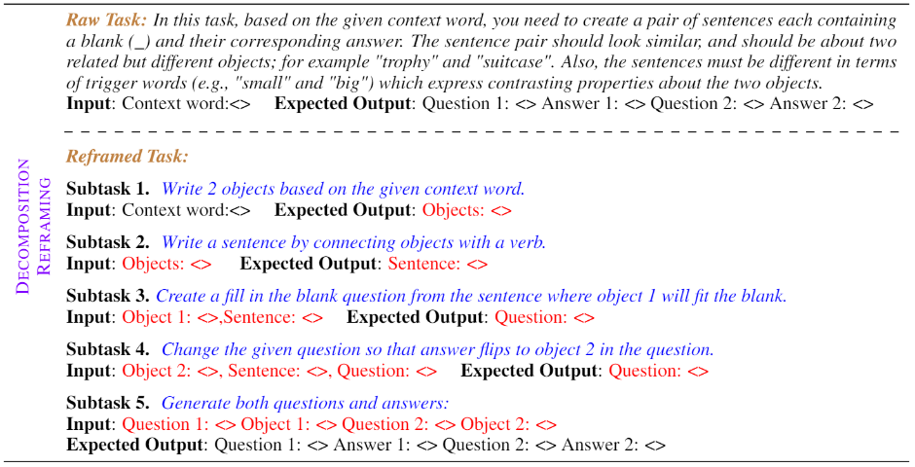
Related Work (Limitations of LMQL)
Task Decomposition and Chain of Thought
It is proved that decomposing a task into multiple smaller subtasks can yield better performance from the language model.
LMQL does not support task decomposition.

Slide 5
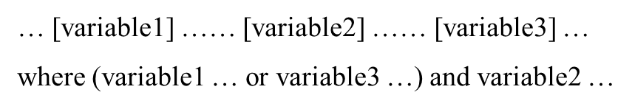
Related Work (Limitations of LMQL)
The Redundant “or” Operator
The “or” operator can make the execution of the query require a lot more decoding, subsequently increasing costs.
Consider the following example where we generate variable1 but don’t immediately satisfy the constraint…

Slide 6
Motivation and Contribution
By formalizing the ability to provide a sequence of tasks to the model and being able to constrain the outputs of each individual task, we enable the user to use an advanced prompting technique to achieve better results from the model.
Three main contributions:
Formalizing decomposition reframing as a language aspect.
Semantics for limiting conjunctive ‘and’ / ‘or’ constraints to one specific variable.
Provide intuitive rules of the execution of query body.

Slide 7
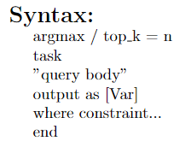
Syntax
argmax/top_k How many possible tokens generated at each step. argmax = 1 / top_k = n
task The start of a new query task
“query body” The query we want to execute. It is within double quotation markers.
output as Optional. It assigns the final response of LLM to a variable so that it can be used by following tasks.
where Optional. It is the constraint of all variables in this task’s scope. Constraints are separated by “;”.
end The end of a query task

Slide 8
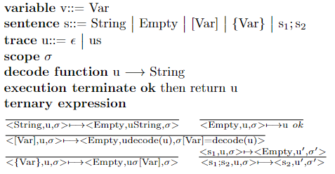
Semantics (Execution of The Body)
Adopted from LMQL’s method of decoding, we define the following semantics rules for queries:
We have a trace comprised of sentences containing variables we want to decode. After the decoding of all sentences, we return the decoded trace and print it.

Slide 9
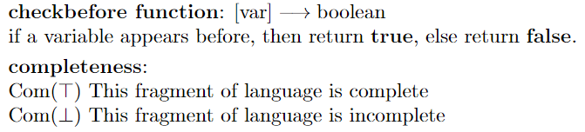
Semantics (Completeness)
Because calling the language model is expensive, we need to do a static completeness check before we execute the query body. If the query does not pass the check, that means this query task is not well-formed. We need to throw an exception.
Since both query and where constraint may contain variables, we need to check both of them. We define a function checkbefore(var) to look whether a variable is defined before.

Slide 10
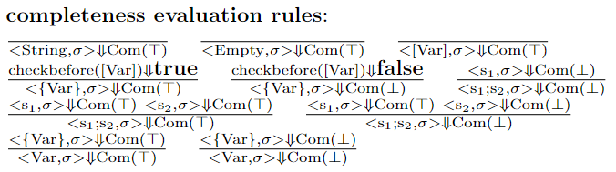
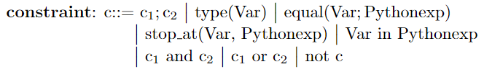
Semantics (Completeness)
The completeness checking rules of the query body.
Constraints that our language support. They need to be checked before execution.

Slide 11
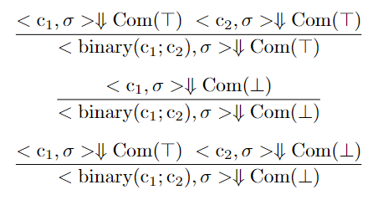
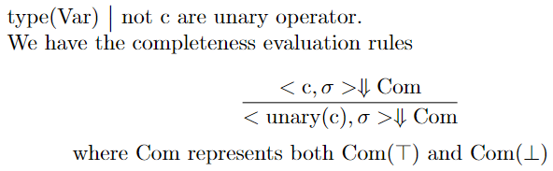
Semantics (Completeness)
Binary constraint operators and their completeness checking rules.
Unary constraint operators and their completeness checking rules.

Slide 12
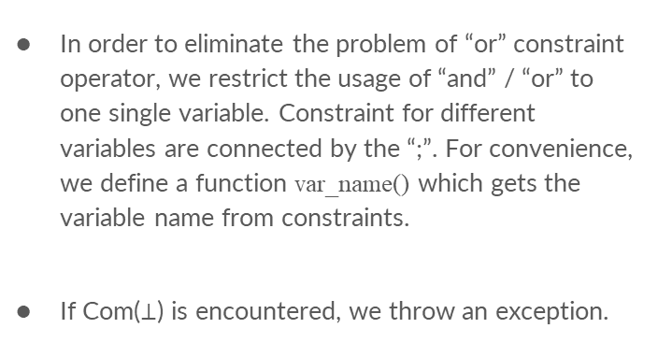

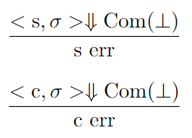
Semantics (Completeness)

Slide 13
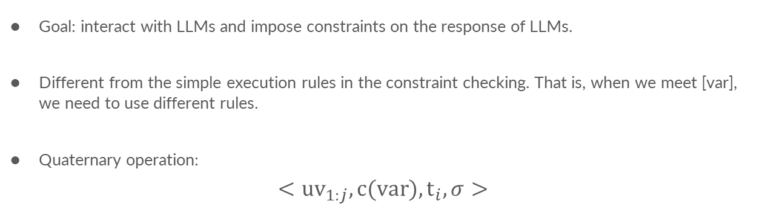
Semantics (Execution with Constraints)
Goal: interact with LLMs and impose constraints on the response of LLMs.
Different from the simple execution rules in the constraint checking. That is, when we meet [var], we need to use different rules.
Quaternary operation:
$$<uv_{1:j},c(var),t_{i},σ>$$

Slide 14

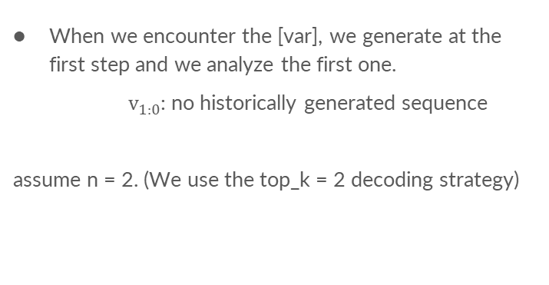
Semantics (Execution with Constraints)
When we encounter the [var], we generate at the first step and we analyze the first one.
$v_{1:0}$: no historically generated sequence
assume n = 2. (We use the top_k = 2 decoding strategy)
step1
[var]

Slide 15
Semantics (Execution with Constraints)
If one token passed the constraint checking, we go on to generate tokens at the second step.
assume n = 2.
step1
step2
[var]

Slide 16
Semantics (Execution with Constraints)
If one token passed the constraint checking and it is <EOS>, we stop and assign the history to the variable.
assume n = 2.
step1
step2
step3
[var]
<EOS>

Slide 17

Semantics (Execution with Constraints)
If one token does not passed the constraint checking, we go on to check the next token possible token at this step.
assume n = 2.
step1
step2
step3
[var]

Slide 18
Semantics (Execution with Constraints)
If the index exceeds the number of n, but it is not the first step, we need to go back.
assume n = 2.
step1
step2
step3
[var]

Slide 19
Semantics (Execution with Constraints)
If the current ith token does not satisfy the constraint, but the previous i-1th token satisfies, we return the history with the i-1th the token.
assume n = 2.
step1
step2
step3
[var]

Slide 20
Semantics (Execution with Constraints)
If the index exceeds the number of n, but the previous i-1th token satisfies the constraint, we return the history with the i-1th the token.
assume n = 2.
step1
step2
step3
[var]

Slide 21

Semantics (Execution with Constraints)
If no token at the first step satisfies the constraint, we raise a failure.
assume n = 2.
step1
[var]

Slide 22
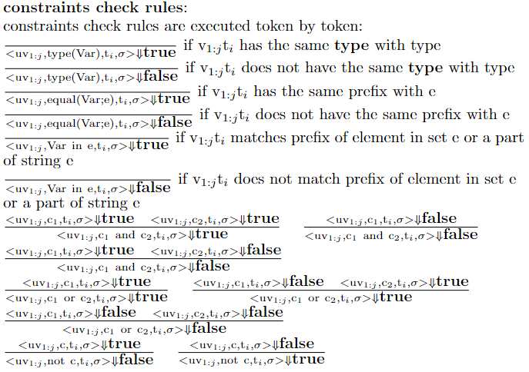
Semantics (Execution with Constraints)
Constraint checking rules: check whether the history sequence with the current token satisfies the constraint.

Slide 23
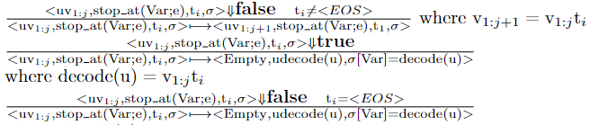
Semantics (Execution with Constraints)
Special rules for stop_at
If stop_at is satisfied, we stop the generation.
If stop_at is not satisfied, we continue to generate.

Slide 24
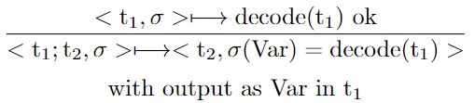
Semantics (Chain of Thoughts)
The output of one task can be used by following tasks.

Slide 25
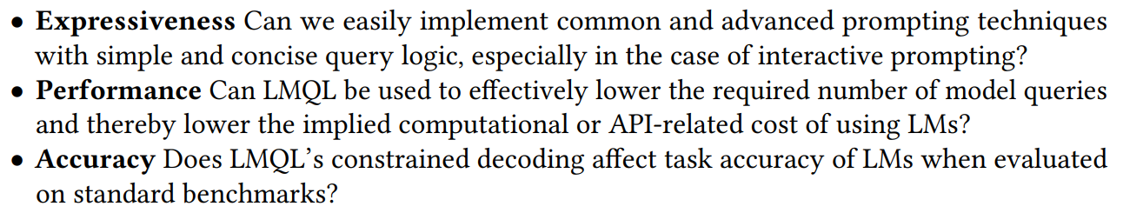
Evaluation
Due to the limitation in conditions, we can only do the expressiveness evaluation.

Slide 26
Limitations and Future Work
We parse the language using regular expressions.
Our language is executed token by token. It is expensive and time-consuming.
The function of our language is limited.

Slide 27
Question
Why we don’t go to check the second token at the first step.
step1
step2
step3
[var]

Slide 28
Question
Designing principle
If we have a sequence of length j that satisfies the constraint, we will not go back to check tokens before the jth step.

